Slide 1
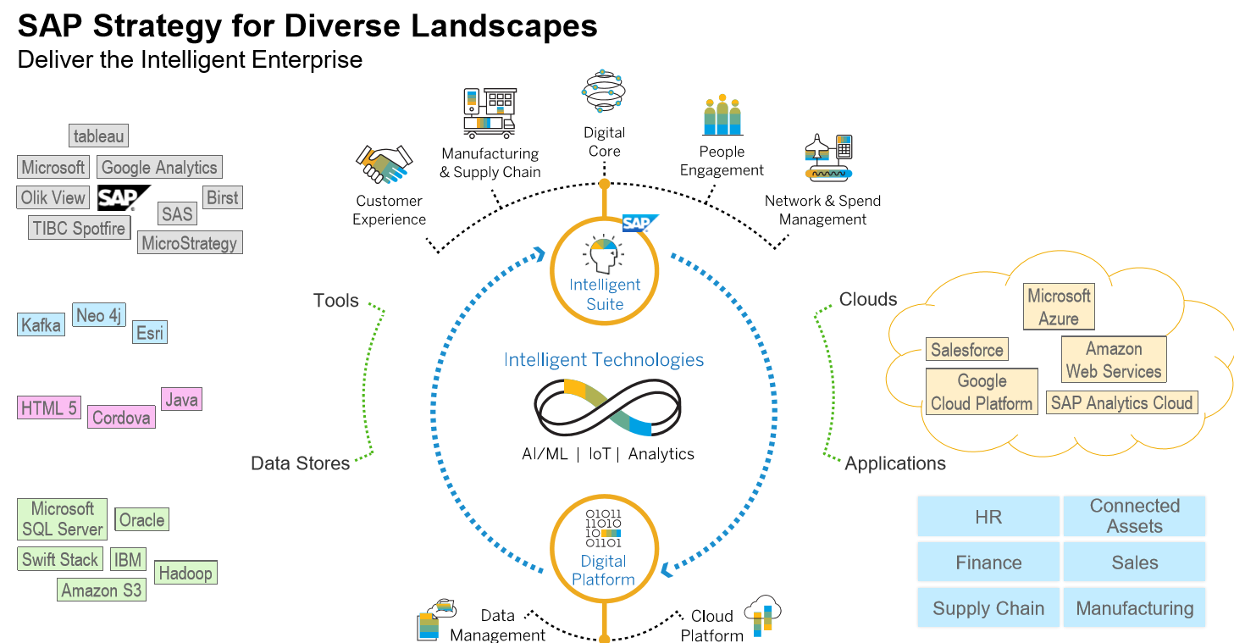
SAP Data Intelligence 3.0 Tool Overview
SAP Data Intelligence is the platform which is used by SAP for building the Intelligent Enterprise. Partners and customers can use it in conjunction with the intelligent suite and for implementing their own use cases.
SAP’s intelligent suite has built-in machine learning and deep-learning capabilities, which are built and based on SAP Leonardo AI business services, technical services of SAP Data Intelligence, and SAP Data Intelligence as a platform.

Slide 2
